Slide 1
ANALYSING VOWEL SOUNDS USING MRI
Demographic trends within vocal tract area functions
& vocal tract resonances for multiple speakers
Jenny Sahng
Supervised by Dr Catherine Watson & Dr Richard Clarke
Department of Engineering Science

Slide 2
MRI in Speech Technology
Many applications e.g. speech aids, Siri
Accurate models of speech & vocal tract (VT) data needed.
MRI a good source of VT shape and vowel quality data.
Project aim:
Validate the analysis of combined MRI-derived data from multiple speakers for the study of demographic trends in vowel sounds.

Slide 3
Measures of Vowel Quality
VT Shape = tongue position = height + backness = vowel quality
Principal components
Area function
VT cross-sectional area
=
Resonant frequencies
distance from lips
PC2 ∝ R1 ∝ height PC1 ∝ R2 ∝ backness

Slide 4
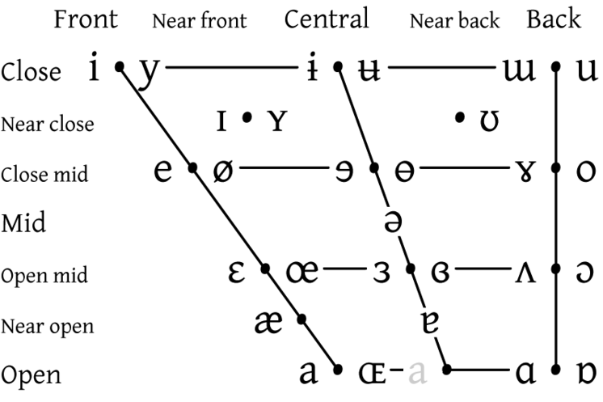
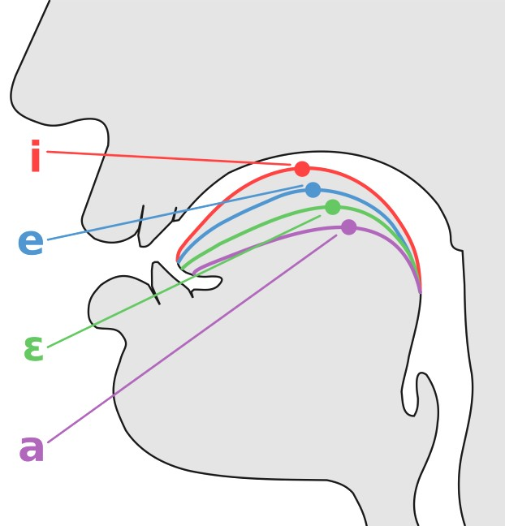
The Vowel Quadrilateral
Front Central Back
High
PC2
∝ R1
∝ height
Mid-high
Mid-low
Low
PC1 ∝ R2 ∝ backness

Slide 5
The Vowel Quadrilateral
Front Central Back
High
PC2
∝ R1
∝ height
Mid-high
Mid-low
Low
PC1 ∝ R2 ∝ backness

Slide 6
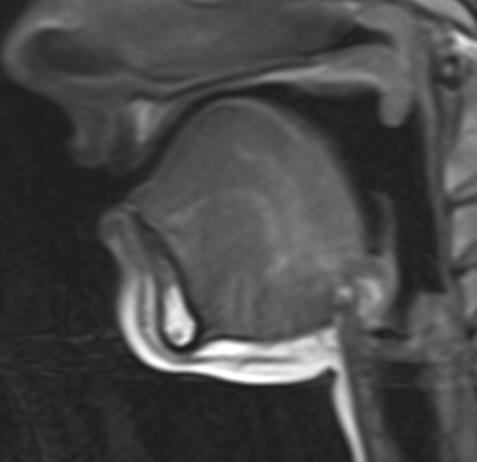
The Vowel Quadrilateral
Front Central Back
High
i
PC2
∝ R1
∝ height
Mid-high
Mid-low
Low
PC1 ∝ R2 ∝ backness

Slide 7
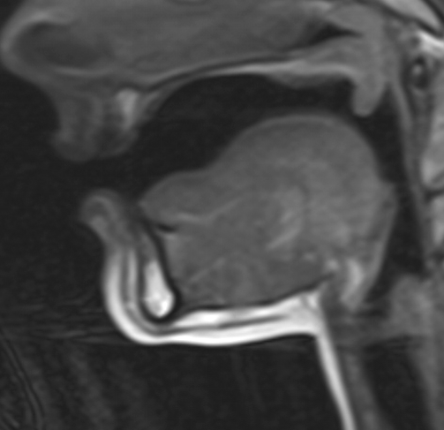
The Vowel Quadrilateral
Front Central Back
High
i
u
PC2
∝ R1
∝ height
Mid-high
Mid-low
Low
PC1 ∝ R2 ∝ backness

Slide 8
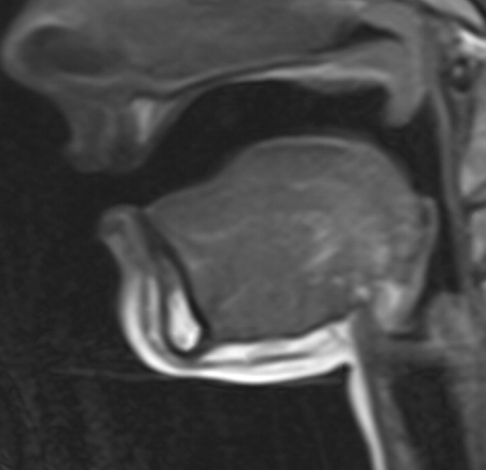
The Vowel Quadrilateral
Front Central Back
High
i
u
ɒ
PC2
∝ R1
∝ height
Mid-high
Mid-low
Low
PC1 ∝ R2 ∝ backness

Slide 9
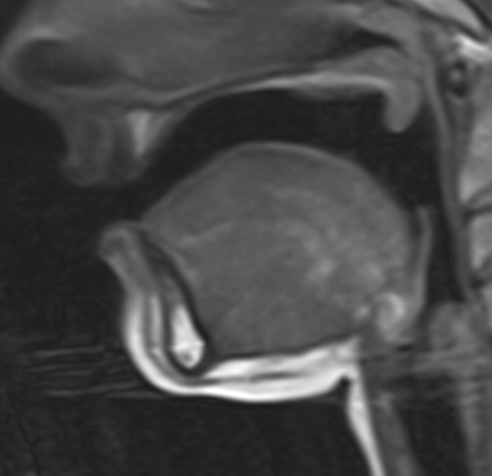
The Vowel Quadrilateral
Front Central Back
High
i
u
PC2
∝ R1
∝ height
Mid-high
æ
ɒ
Mid-low
Low
PC1 ∝ R2 ∝ backness

Slide 10
The Vowel Quadrilateral
Front Central Back
High
i
u
PC2
∝ R1
∝ height
Mid-high
æ
ɒ
Mid-low
Low
PC1 ∝ R2 ∝ backness

Slide 11
Methods
Principal components
 |  |  | Compare measures of phonetic height and backness
Resonant frequencies
MRI images |  | Area functions
CMGUI, Perl
MATLAB
R

Slide 12
Results Validation
> 70% of variance captured by PC1 + PC2 (and R1 + R2).
Capturing most of the information in data.
Strong inter-speaker & intra-speaker correlations.
Information captured is about vowels, not speaker differences.
Methods and results are repeatable.

Slide 13
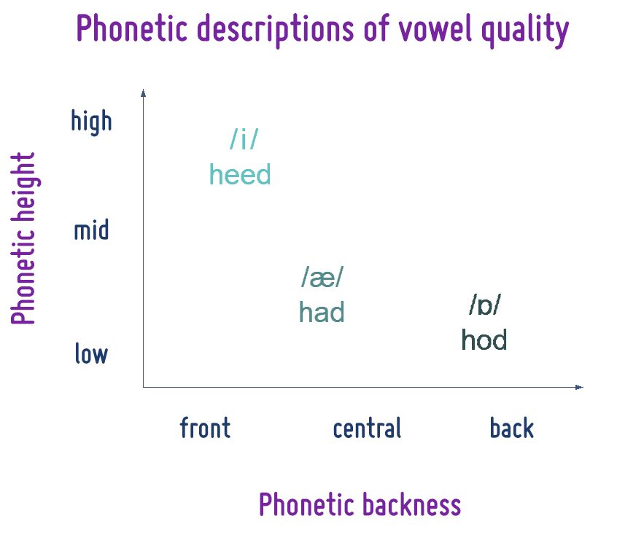
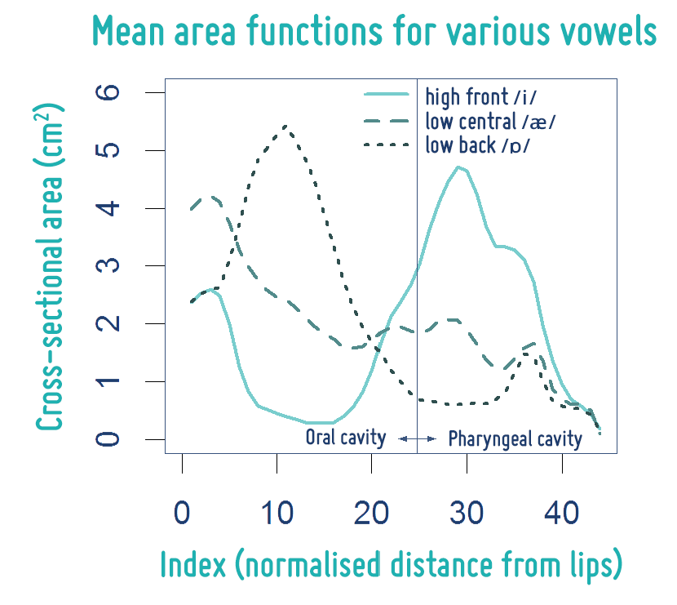
Key Results

Slide 14
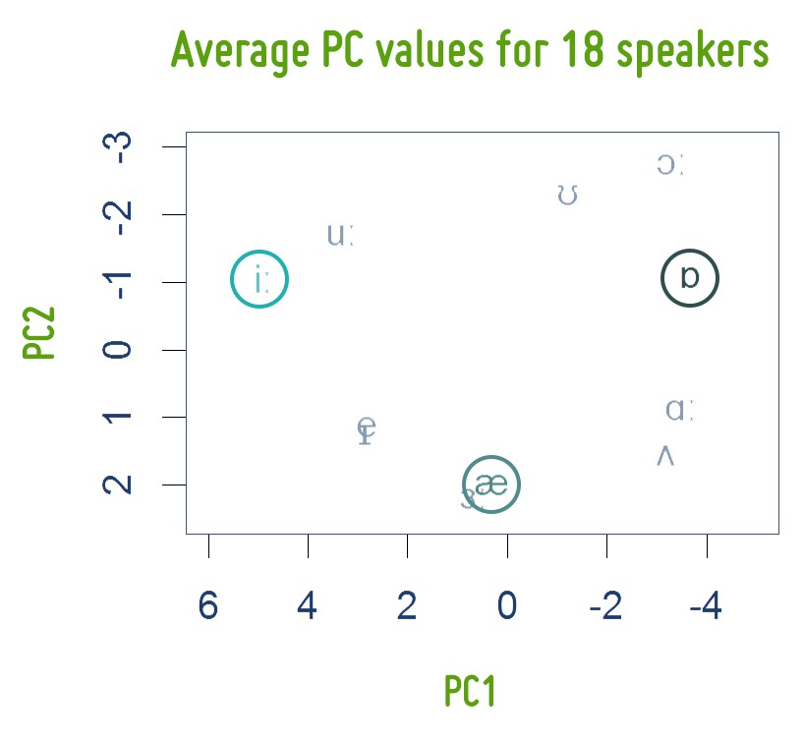
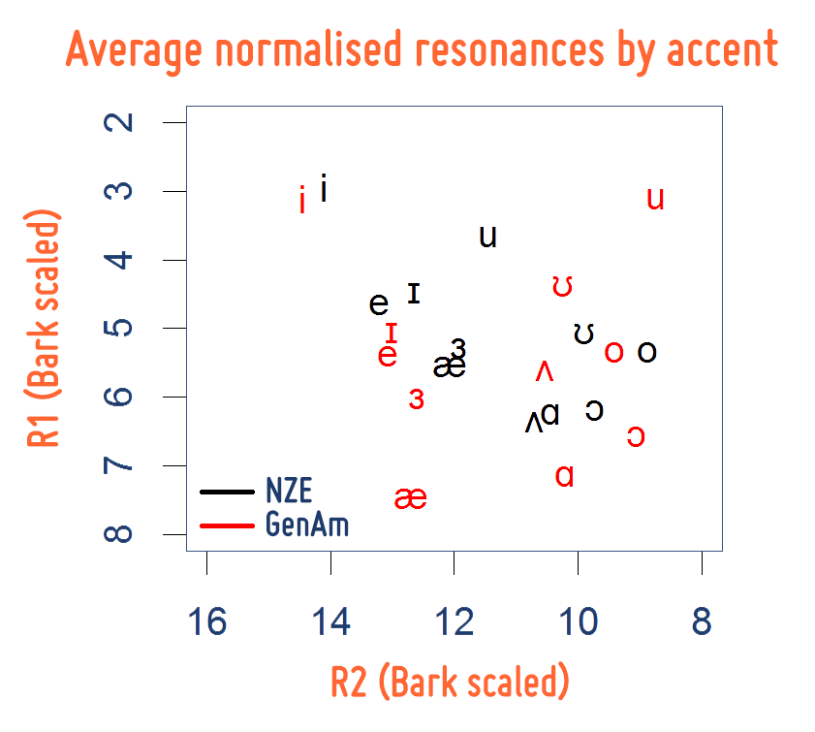
Key Results

Slide 15
Key Results

Slide 16
Conclusions & Future Work
MRI-derived area functions are a valid source of meaningful phonetic data.
Large data sets from multiple speakers can be analysed together to reveal demographic trends.
This method could be further developed to use other forms of VT data, or other transformations.
Exploring these variations in our speech systems is key to
improving speech technology.

Slide 17
Questions?
References
Watson, C. I. (2014). Mappings between vocal tract area functions, vocal tract resonances and speech formants for multiple speakers. In INTERSPEECH (pp. 1993-1997).
R. Carré. From an acoustic tube to speech production. Speech communication, 42(2):227–240, 2004.
J. Harrington and S. Cassidy. Linear Predictive Coding. In Techniques in speech acoustics, volume 8, (pp. 220-240). Springer Science & Business Media, 1999.
Story, B. H. (2005). Synergistic modes of vocal tract articulation for American English vowels. The Journal of the Acoustical Society of America, 118(6), 3834-3859.
Image credit for vowel quadrilateral:
http://lizzlovesaccents.blogspot.co.nz/2013/03/tools-of-trade-ipa-part-2.html

Slide 18
Appendix

Slide 19
The Vowel Quadrilateral
Front Central Back High
PC2
∝ R1
∝ height
Mid
Low
PC1 ∝ R2 ∝ backness

Slide 20
11 simple vowels of NZE
iː ɪ e ɜː
æ ɑː ɒ ʌ ɔː ʊ uː
heed hid head herd had hard hod hud hoard hood who’d
Front
Central
Back
High
Mid
Low

Slide 21
Formants
= resonant frequencies + lip rounding + glottal filter
-F1
~ height
-F2
~ backness

Slide 22
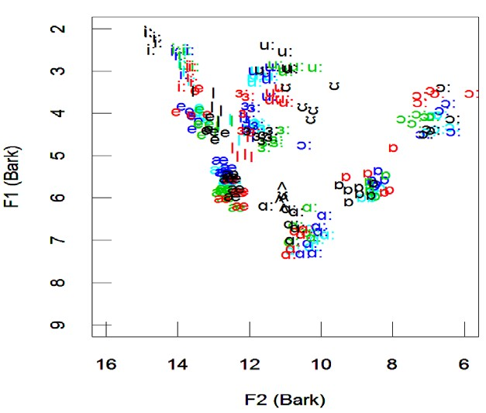
Formants
= resonant frequencies + lip rounding + glottal filter

Slide 23
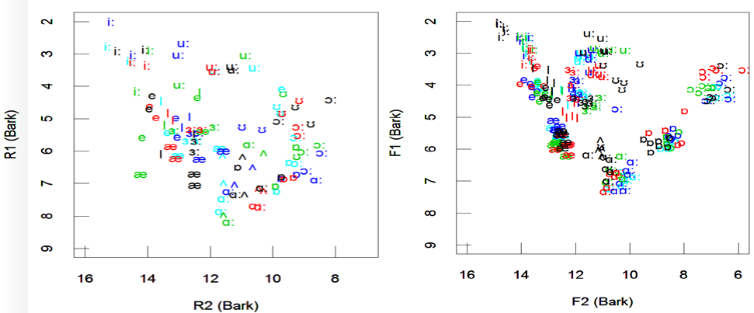
PCA, Resonances (MRI) vs.
Formants
1.0
 | æ _{I} ɑ: I ʌ ʌʌ^{ɑ:} ʌ ^{æ ᴈI :} e _{ʌ} ɑ: _{ɑ: æ æ}æᴈæ: _{ᴈ}I: ^{ɑ:} ɒ æe^{e} e ɑ: ɑ_{ɑ}:_{: ɑʌʌ:} æ _{ᴈæ}ᴈ:: I ^{ᴈ}I : _{ʌ æ ᴈ:}eᴈ_{I}: _{ᴈ}e _{I} : _{I} I ʌ e e i: i: ɒ i: _{ɒ ɒ}ɒ ɒ ʊ ^{ᴈ: e} _{i:} i: _{ɒ}^{ɒ e} i: _{i:} i: ɔ:ɔ: ^{ɒ} _{u:} u^{i:}: ^{i:} ɔ:^{ɔ:} ʊ _{ʊ ɔ: ʊ u}uu: : _{ɔ: ʊ ʊ} u:_{u:} ^{ɒ}ɔ: ^{ʊ} ʊ u_{u}:: ^{u:} ɔ: ʊ ɔ: ʊ
0.5
0.0
PC2
-0.5
-1.0
-1.5
-2
-1
0
1
2
PC1
Principal components
Resonant frequencies
Formant s
 | Derived from MRI images
Derived from speech recordings

Slide 24
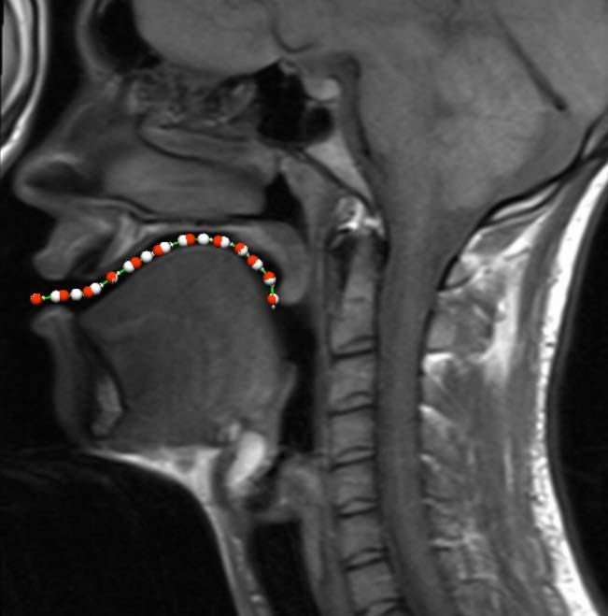
Calculating the Area Function
1. Identify the vocal tract mid-line (oral cavity shown)

Slide 25
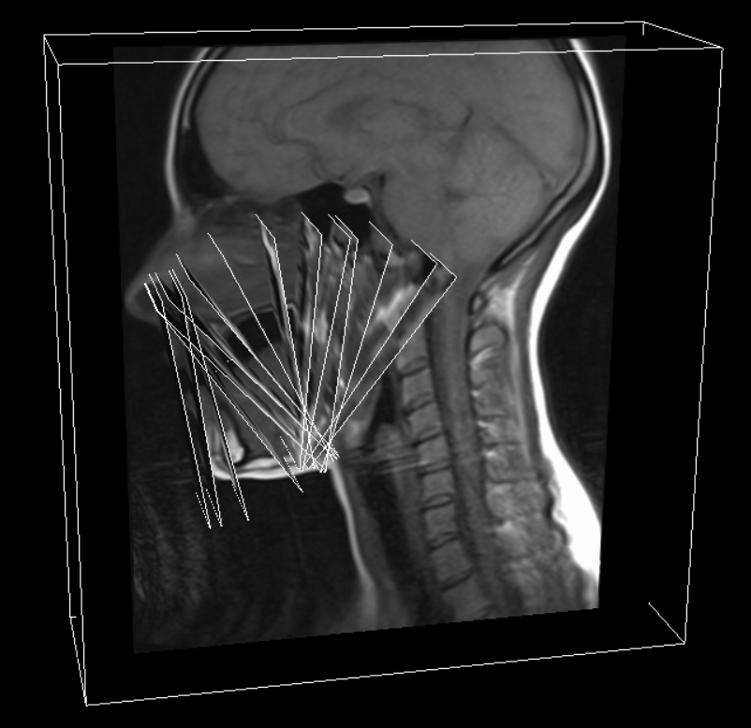
Calculating the Area Function
2. For each node, generate a slice perpendicular to the curve

Slide 26
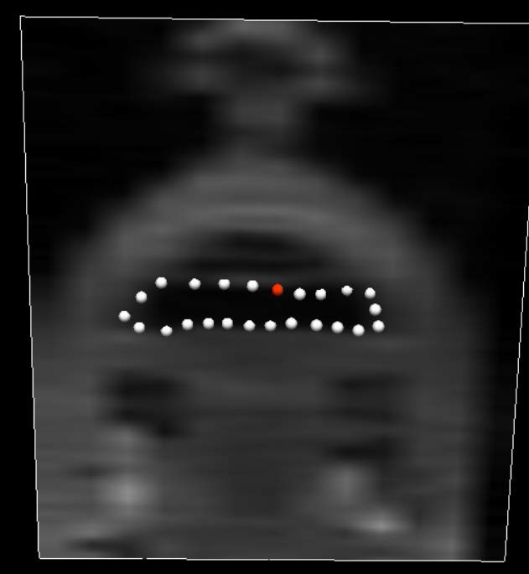
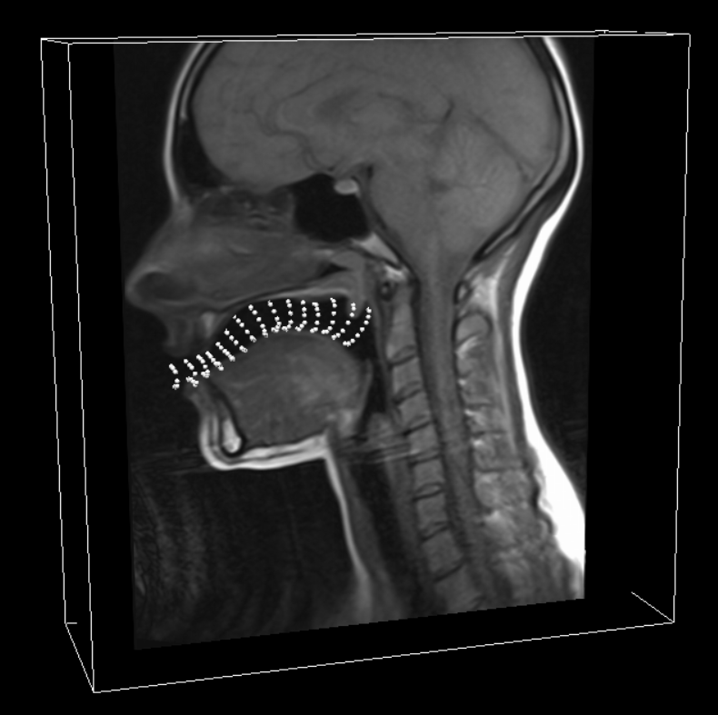
Calculating the Area Function
3. Mark the outline of the vocal tract cavity on each slice

Slide 27
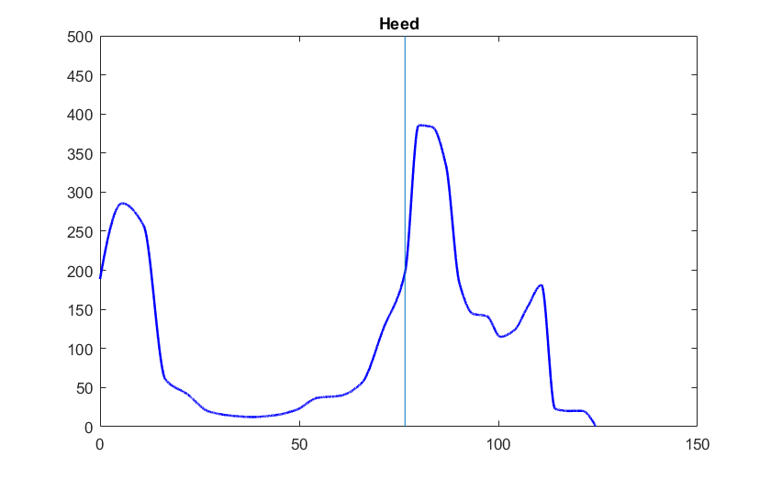
Calculating the Area Function
Repeat above steps for pharyngeal cavity
Combine area data from oral & pharyngeal cavity

Slide 28
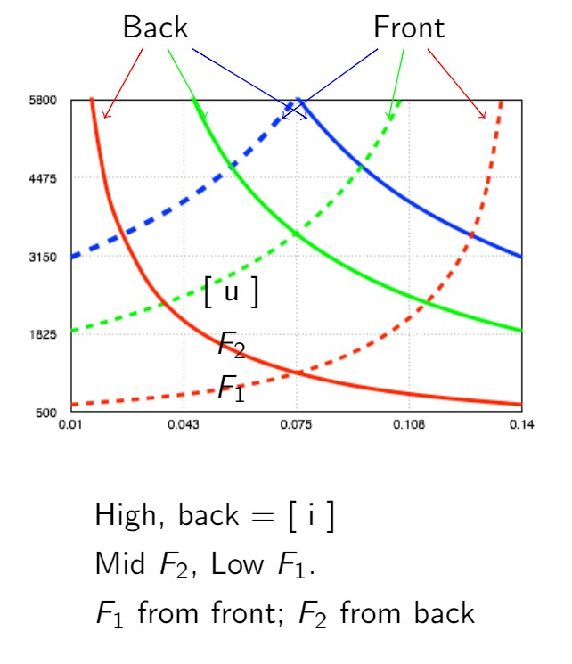
Resonances by cavity

Slide 29
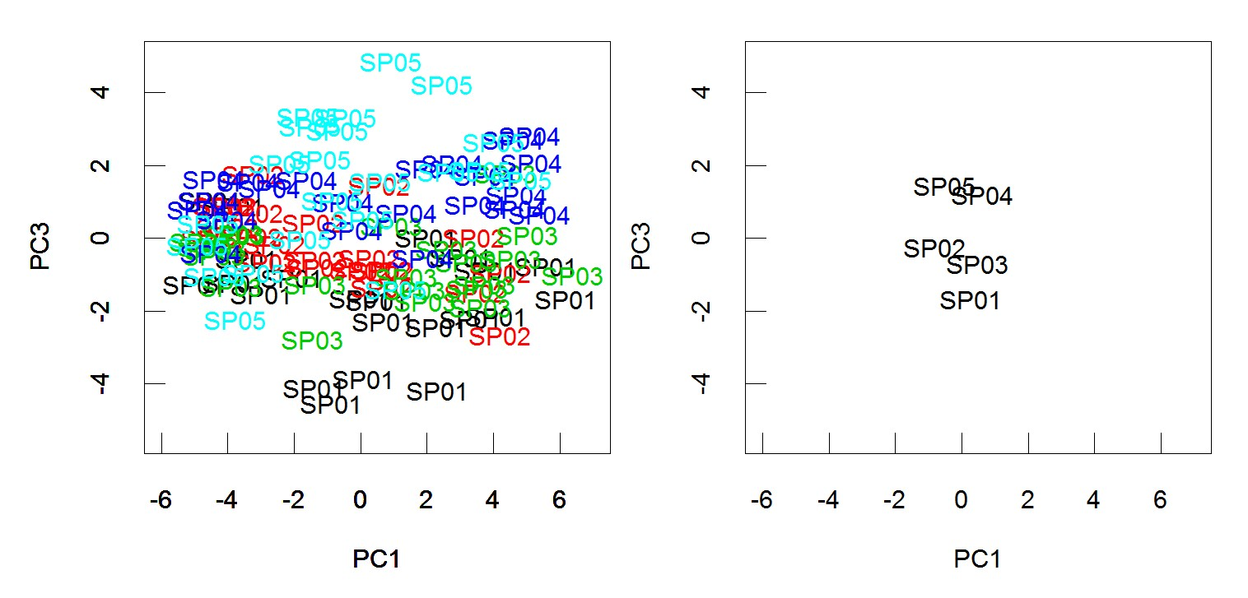
PC3 – Individual Speaker Differences

